Slide 1

Aiding those who need through programming
AMARNATH

Slide 2
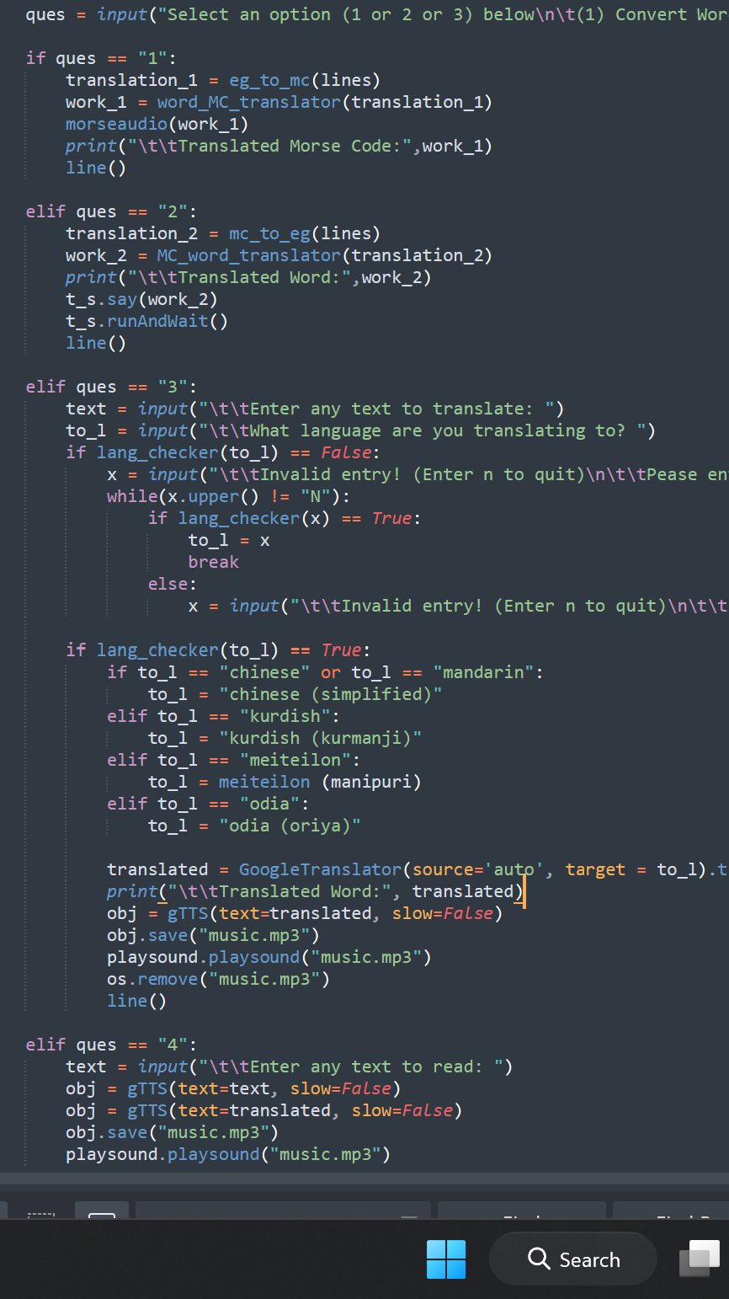
Agenda
ABOUT ME
INTRODUCTION
LISTENING AID
TRANSLATOR
SECRET MESSAGES
WHY IT’S IMPORTANT

Slide 3

About me
I’m Amarnath, a Computer Science sophomore student at Norwich University. Born and raised in India. I'd describe myself as nurturing, patient, mature, and responsible person. My life as a Computer Science Peer Tutor, Residential Advisor, and Lead Ambassador for Norwich Undergraduate Research introduced me to many people across the world, where people struggle with their disabilities. My ultimate goal is to use my programming skills to program software that aids people in their daily life.

Slide 4
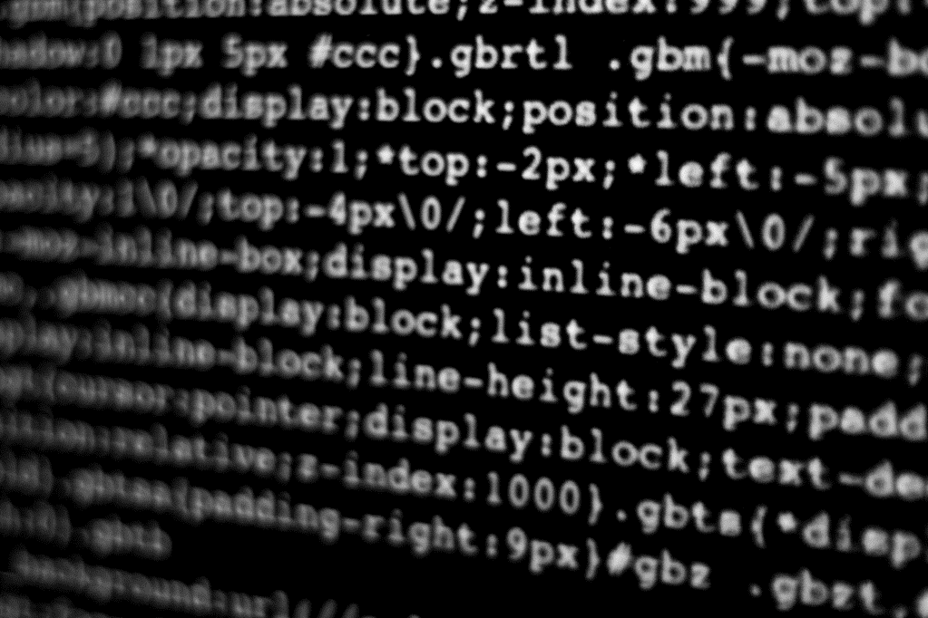
Introducing the program

Slide 5
I have coded a multi-functional Hearing Aid program. Users have the option to choose how they want to use the function. Functions provided are translating from one language to another (user’s choice), reading the text of any preferred language for those who cannot see or read, and sending secret messages. The programs can be loaded into a hearing aid and any other devices with additional work.

Slide 6
The Ultimate Goal is to provide aid to those who need And it starts here.
One of my relatives in India is unable to speak or listen properly. I want her to be able to listen, read and communicate properly. Even though she cannot access my program and use them for her, my journey continues to program these codes into a device that utilizes all of these. My goal is to program them into a hearing aid that uses my code to automatically detect the language and translate it into “Tamil” – a south Indian language. Then, it reads other language texts using AI and translates them into Tamil. That will make her life much easier. Programs like these might not benefit everyone in their daily life, but they help some people to experience daily life casually. My journey begins with her and hopefully reaches many who might need aid – A PROGRAMMING HAND

Slide 7

Why it is important?

Slide 8
Hearing Aid
A program that reads the text, commonly known as text-to-speech. The program uses gTTS to read the messages.
This program takes texts in any preferred language and outputs audio.
This works by taking any texts and then using gTTS to read the text and then saving them in an mp3 form.
Then this program uses the playground to play the voice recorded in the mp3 format.
Once the audio is played, it will be deleted from the OS immediately; this saves much space and creates unnecessary files that users might never reuse.
This program can then be loaded into a machine to use as an aid in hearing for people who have hearing issues.

Slide 9
Programming: Hearing Aid
Import gTTS from gtts
Get the input from the user, then create a variable that stores the output.
gTTS takes 2 to 3 parameters, first – text to read, second – the language of the input, and speed of the output as slow or not.
If you’re not sure of the language, it can be left empty as the functions automatically find the language of the texts and then reads in that language.
gTTs(text=“___”, lang=“___”, slow=“True/False”)
The output will be saved using .save(“something.mp3”) function
Then uses .playsound(“something.mp3”) to play the sound
Then it will be deleted from the system using os.remove(“something.mp3”)

Slide 10
Hearing aid: Translator
A program that utilizes google translate library to translate text messages of any preferred language to any preferred language.
This conversion is divided into multiple parts beginning with user input.
User then decides what language they want the text to be translated into by typing the language name
Google translate’s targeted language can be hard to find because there's no Chinese in their language library; instead, they have Chinese (simplified) and Chinese (traditional), so my program converts them into the language name the program wants it to be.
Then the output text is printed out and read out using the functions we used before
This can be programmed into the hearing device or any device of choice to convert any language into the preferred language.

Slide 11
Programming: Translator
Import GoogleTranslator and DeeplTranslator from deep_translator
Created a function to check whether the user-entered language is available or not
The users are given unlimited chances to re-enter the language correctly if they make a spelling mistake until they choose not to enter a language.
Since Chinese is written as Chinese (traditional) etc., users might just enter Chinese, so a few if-else statements I made check them and convert them into required language codes.
Then it is passed as language into GoogleTranslator(source=“auto”, target = preferred language)
The auto keyword saves coding by automatically finding the source
Then .translate(text=___), translates the texts into the targeted language
Then gTTS and Play sound and OS are used to speak the text or play the audio

Slide 12
Hearing aid: Secret messages
This program uses Winsound library to produce sound at specific frequencies for a given duration. And uses pyttsx3 to read texts.
I created a function to produce a beep sound and pause (absence of sound) to produce sound for morse codes using Winsound. Then created another function to produce different beep sounds for dot and dash/hyphen
Method used here is reading from a text file that has basic information on the morse code and its respective characters. Users can change the morse into any secret code they want it to be.
Then, multiple functions are put together to store those as dictionaries; they are then stored inside a dictionary and later used in comparing the morse code and their character and vice versa.
This function uses a function with pyttsx3 to read the output if it’s a text message.
The frequency used is 417 Hz which is a Solfeggio Frequency. The 417 Hz frequencies facilitate change, stay calm, and relieve stress. So, listening to the sounds helps everyone, especially in the Military, since they sometimes use Morse for communication. When used in Hearing Aids, it helps users send messages.

Slide 13
Programming: Secret code
In this case, I’m using morse to send secret messages, more can be replaced by any secret code of your choice, or you can replace it with encoding the texts and then decoding it using python.
My reading file function reads the file using .readlines() and stores the dictionary into an English to-morse and more to-English file by using .split() and .rstrp() functions and a series of if-else statements and for loops.
That file is then used to compare it with the user input character by character and then finds the morse code associated with it.
The morse code is printed out directly, but since the function is inside of a loop, every character will be outputted in sequences.
Then used the text to read and beep sound function I created using Winsound and Playsound to output a reading voice/sound

Slide 14



THANK YOU
The code is available on request
Amarnath
+1 802-839-0241
aamarnat@norwich.edu
(Ash)
+91 735-662-5288
heyitsmeamar@gmail.com

